Slide 1
News Web App
Requirements
Pranaav, Caleb, Jude

Slide 2
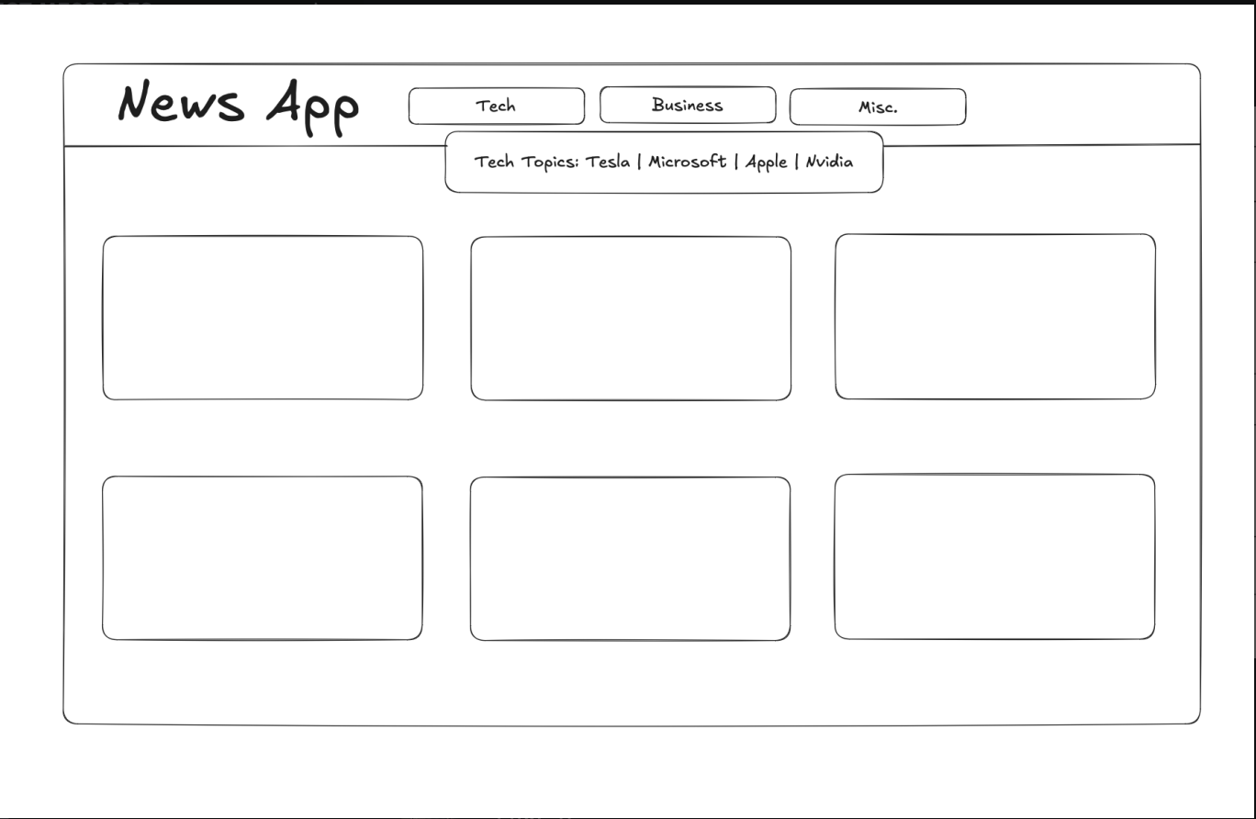
Frontend (Must have)
Grid/list of Articles About Recent Events (Functional)
Dynamic grid to showcase latest news articles
Keyword Search (Functional)
Able to find articles on specific topics or interests
Category Tabs (Functional)
Includes category tabs which user might like to see, ie: Tech, Business, Politics, etc.
Responsive Design (Functional)
Able to be viewed on any device
Reasonable Loading Time (Non-Functional)
Optimized for performance, low wait times

Slide 3
Backend (Must Have)
Search History (Functional)
Keeps records of user’s previous search queries for efficient revisiting
Integration with NewsAPI (Functional)
Allows application to fetch latest news articles from wide array of sources
ChatGPT summary (Functional)
Allows user to hover over any news article and receive a quick summary
Implement Like/Heart System (Functional)
Adds “like” ability, allowing users to store articles for later reading
Login System (Functional)
Secure login system for user account creation and access

Slide 4

Frontend (Nice to have)
Article previews
Dark mode
Customizable categories
Animations/Transitions

Slide 5

Backend (Nice to have)
User Personalization
Sharing options

Slide 6
QUestions

